Slide 1
Building daily CalLite model from scratch – daily version

Slide 2
Goals
Learn how to rebuild CalLite schematic North of Delta model from scratch using daily data
Including Delta operations and requirements will be saved for later
Review how WRESL routes water without actual channel routing like Muskingum method
Determine the validity and corroborate the results

Slide 3
North of Delta Daily 1-year model
Time period
August 2019-August 2020 (mostly water year 2020)
Progresses as phases and sub-phases which can be done on parallel paths
Feather River to Confluence
Yuba River to Confluence
Feather-Yuba to SacFeather confluence
Shasta to Red Bluff
Trinity to Red Bluff
Shasta-Trinity to SacFeather confluence

Slide 4
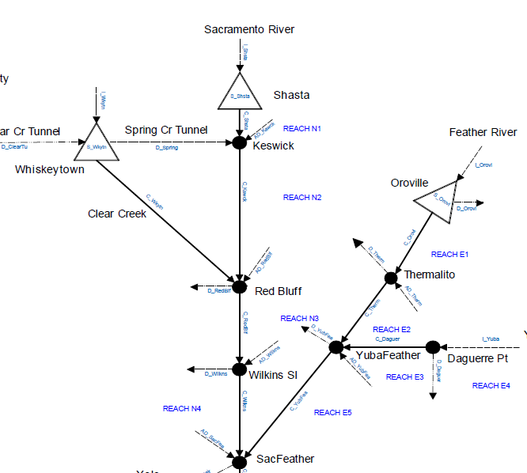
Schematic

Slide 5
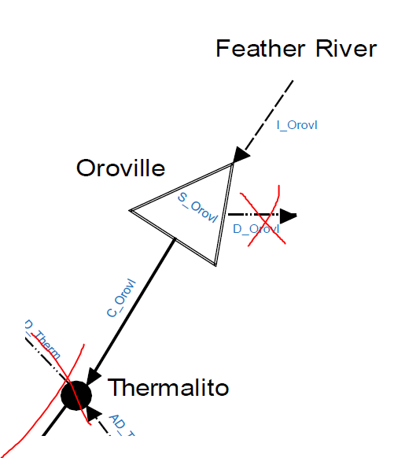
Phase 1.1 – Oroville dam and outflow only
Develop very simple model
Inflow to Oroville reservoir
Oroville reservoir storage
Release from Oroville storage
No deliveries/demands yet
Output
Daily Oroville releases

Slide 6
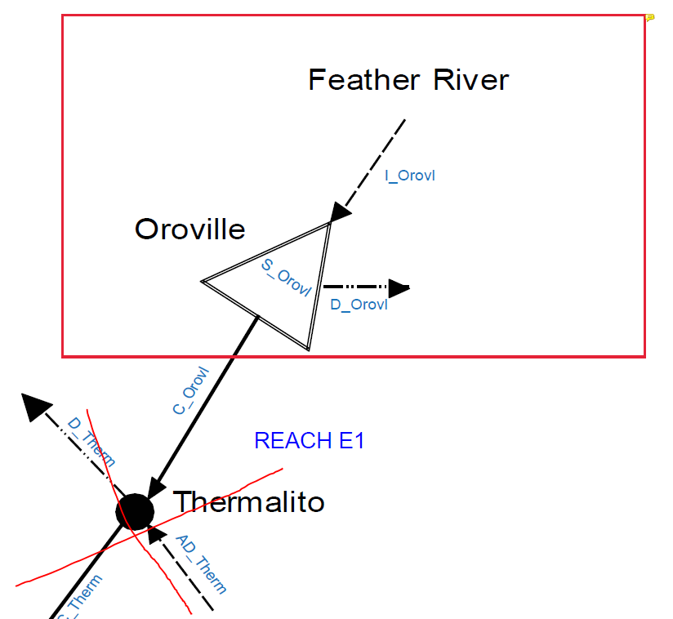
Phase 1.2 – Include Oroville deliveries
Include D_OROVL missing from previous step
Output
Oroville releases, storage, deliveries

Slide 7
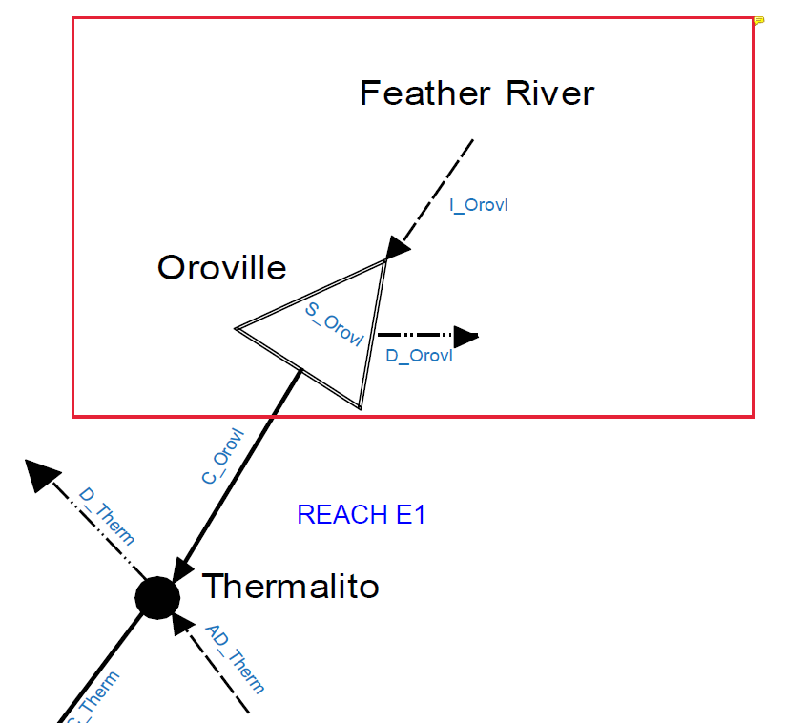

Phase 1.3 – Include Thermalito node
No deliveries yet
Just the passing of water from C_OROVL to C_THERM
Need to review the purpose of Accretion-Depletion (AD) terms and how to calculate
Output
Flow from Thermalito (C_THERM)

Slide 8
Phase 1.4 – Include Thermalito deliveries
Add demands for D_THERM
Need to review the purpose of Accretion-Depletion (AD) terms and how to calculate
Output
D_THERM

Slide 9
Phase 1 data requirements
Lake Oroville
Inflow (TAF/day)
Initial storage
Level 5 storage
Evaporation rate
Oroville water rights demands
Minimum groundwater pumping

Slide 10
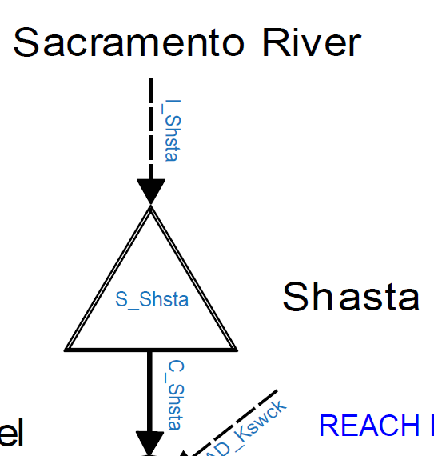
Phase 2.1 – Shasta dam and outflow only
Develop very simple model
Inflow to Shasta reservoir
Shasta reservoir storage
Release from Shasta storage
Output
Daily Shasta releases

